Slide 1
Priority Que:
A priority queue is an abstract data type that behaves similarly to the normal queue except that each element has some priority.
Example:
suppose we have some values like 1, 3, 4, 8, 14, 22 inserted in a priority queue with an ordering imposed on the values is from least to the greatest.

Slide 2
Characteristics:
Every element has priority associated with it.
An element with the higher priority will be deleted first.
If two elements in a priority queue have the same priority, they will be arranged using the FIFO principle.

Slide 3
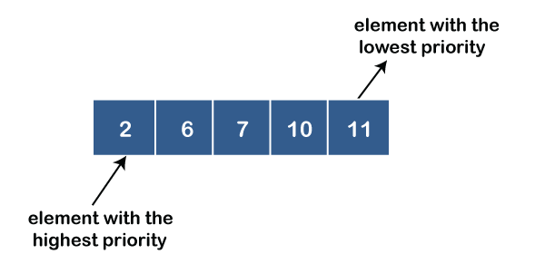
Types:
Ascending order priority queue:
In ascending order priority queue, a lower priority number is given as a higher priority in a priority.

Slide 4
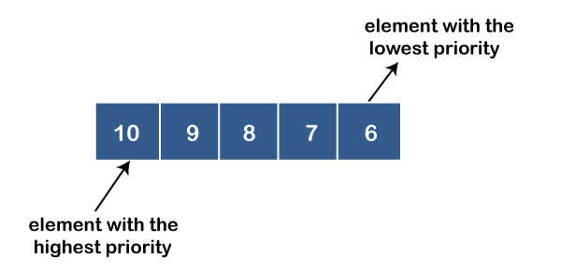
Descending order priority queue:
In descending order priority queue, a higher priority number is given as a higher priority in a priority.

Slide 5
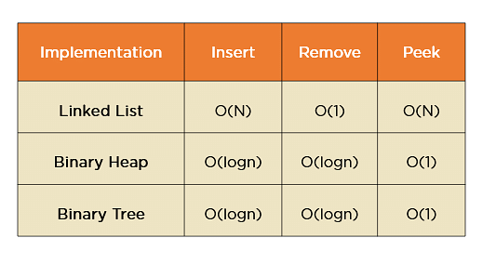
Different Implementation Strategies for Priority Queue:

Slide 6
Addition Algoritham
1. Create a new node with the given element and priority.
2. Insert the new node into the priority queue based on its priority.
3. Heapify up to maintain the max-heap property:
i = length(PQ) - 1
while i > 0 and PQ[parent(i)].priority < PQ[i].priority:
swap(PQ[parent(i)], PQ[i])
i = parent(i)

Slide 7
Poll algoritham:
maxIndex = findMaxIndex(PQ)
swap(PQ[maxIndex], PQ[length(PQ) - 1])
removedElement = PQ.pop()
function findMaxIndex(PQ):
maxIndex = 0
maxPriority = PQ[0].priority
for i from 1 to length(PQ) - 1:
if PQ[i].priority > maxPriority:
maxPriority = PQ[i].priority
maxIndex = i
return maxIndex
1. If the priority queue is empty, return an error (underflow).
2. Find the index of the element with the highest priority in the array.
3. Swap the element found in step 2 with the last element in the array.
4. Remove the last element from the array.

Slide 8
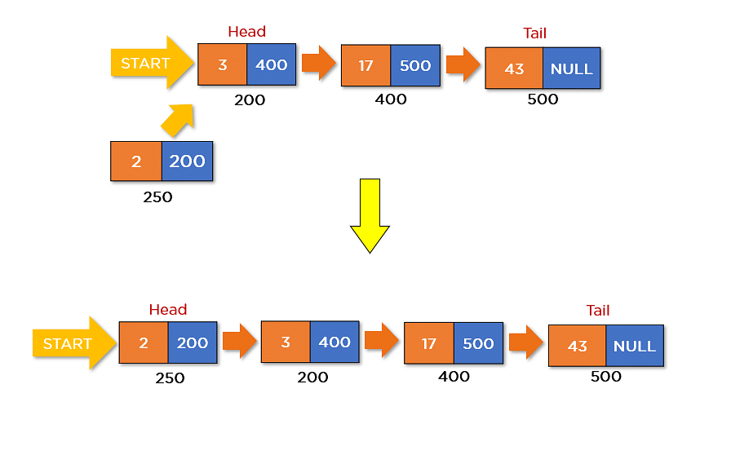
Representation:

Slide 9
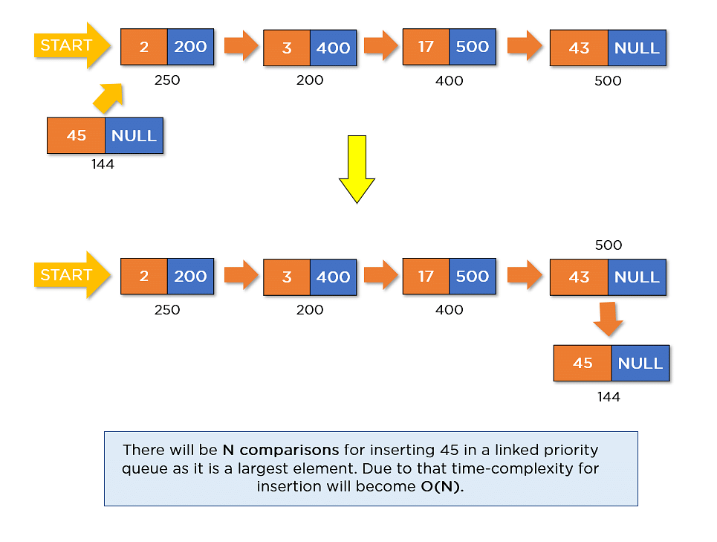

Slide 10
Reason to use:
Efficient Priority Management:Priority queues are designed specifically for efficient management of elements based on their priority.
Key Operations:Priority queues provide essential operations like insertion and removal of elements with the highest priority (or lowest, depending on the implementation).
Well-Defined Behavior: making them ideal for scenarios where you need to ensure predictable processing based on priorities.
Predictable Performance: Priority queues typically offer predictable time complexity for their operations, ensuring that you can reason about the performance of your code more easily.

Slide 11
Applications:
Dijkstra's Algorithm:
This algorithm uses a priority queue to find the shortest path in a weighted graph.
Network Routing:
In networking, priority queues are used for Quality of Service (QoS) to prioritize packets with
different levels of service.
Emergency Services:
Emergency response systems use priority queues to manage and dispatch resources to critical
incidents based on their urgency.
Adaptive Data Structures:
Some data structures adapt dynamically to maintain their properties, like the self-balancing binary search tree.

